Slide 1

Functional Programming in Java 21
By Kevin Nyquist, AmirAli Mirian,
Bahram Afsharmanesh, and Austin Downes

Slide 2
Outline
Principles of Functional Programming
Java.util.function
Functional Interfaces
Function
Predicate
Consumer
Java.util.stream
Looping over Collections
Lambda functions
Reduction
Concurrency
Ordering

Slide 3

1. Intro to Functional Programming
Key Characteristics:
Declarative rather than imperative Code that seeks to focus on the “what” of a problem versus the “how”
Pure Functions Deterministic meaning the output is only determined by the input, not on outside factors, and there are no side effects in changing the state of the program
Avoids Loops FP focuses on recursion rather than loops, iterating until a base case is reached

Slide 4
1. Intro to Functional Programming
Pros
Better Readability FP describes the outcome of computations
Suitable for Parallel Programming Because the output is independent of the state of the program
Easier to test and debug Functions are unaffected by unexpected changes in the external state and outputs are immutable
Cons
Potential Performance Issues FP copies data to perform functions on it, and this can use up a lot of time and memory
Less Intuitive When Working With Program State and I/O
To address this you move I/O operations to the outer layer of your program

Slide 5
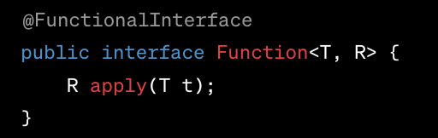
Functional Interfaces
The java.util.function package provides predefined functional interfaces like Function, Predicate, and Consumer
These interfaces are fundamental for creating your own functions to utilize as more concise lambda expressions and use with other FP features such as streams

Slide 6
The Function Interface
Definition The function interface is used to implement functional programming in Java. It represents a function that takes one argument and produces a result.
Functions in this Interface
apply: This method takes one argument of type T and returns the result with type R
andThen: This function takes another function as input and returns a composed function where the second function will be executed after the first one.
compos: This function takes another function as input and returns a composed function where the second function will be executed first and then the first function.
identify: This is a function that only returns it’s input argument.

Slide 7
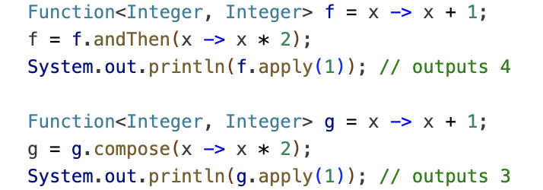
Function Example

Slide 8
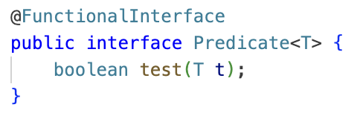
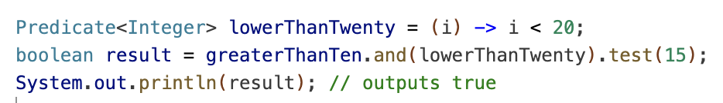
Predicate
Definition This interface improves manageability of code, helps in unit-testing them separately.
Functions
isEqual. Returns a predicate that tests if two arguments are equal
and. Returns a composed predicate that represents a short-circuiting logical AND
negate. Returns a predicate that represents the logical negation
or. Returns a composed predicate that represents a short-circuiting logical OR
test. Evaluates this predicate on the given argument

Slide 9
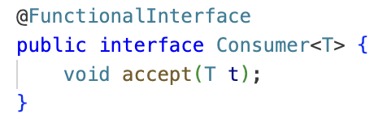
Consumer
Definition This interface represents a function which takes in one argument and produces a result. However these kind of functions don’t return any value.
Functions
accept. This method accepts one value and performs the operation on the given argument.
andThen. This method returns a composed Consumer wherein the parameterized Consumer will be executed after the first one.

Slide 10
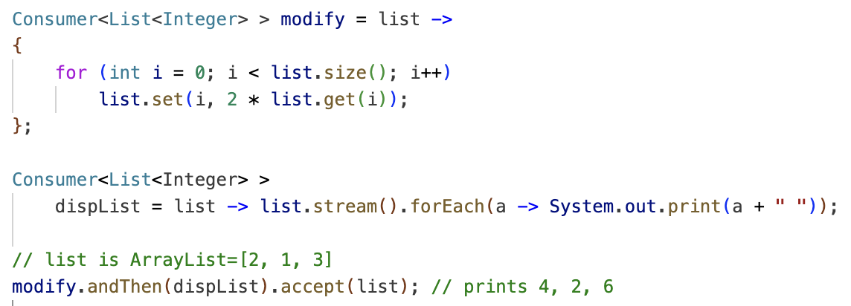
Consumer Example

Slide 11
Intro to Java Stream
Definition Sequence of elements that can be processed in a declarative and efficient way.
Key Characteristics
No storage. A stream is not a data structure that stores elements; instead, it conveys elements from a source such as an array through a pipeline of computational operations.
Functional in nature. An operation on a stream produces a result, but does not modify its source.
Laziness-seeking. Many stream operations, such as filtering, mapping, are lazily, exposing opportunities for optimization.
Possibly unbounded. While collections have a finite size, streams need not.
Consumable. The elements of a stream are only visited once during the life of a stream.
Notes:
In Java streams, everything we have seen comes into action.

Slide 12
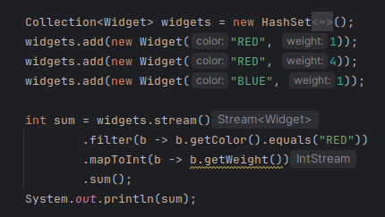
Stream Operations and Pipelines
Example of a stream
Source: for example a Collection
Intermediate operations
Terminal operations

Slide 13
Stream Operations and Pipelines
Some intermediate and terminal operations
Terminal operations | Boolean allMatch(Predicate<? super T> predicate)
 | Boolean anyMatch(Predicate<? super T> predicate)
 | Long count()
 | Void forEach(Consumer<? super T> action)
Intermediate operations | Stream<T> distinct()
 | Stream<T> filter(Predicate<? super T> predicate)
 | IntStream mapToInt(ToIntFunction<? super T> mapper)
 | Stream<T> sorted()

Slide 14
Lambda function
Example of lambda function
Predicate
Function

Slide 15
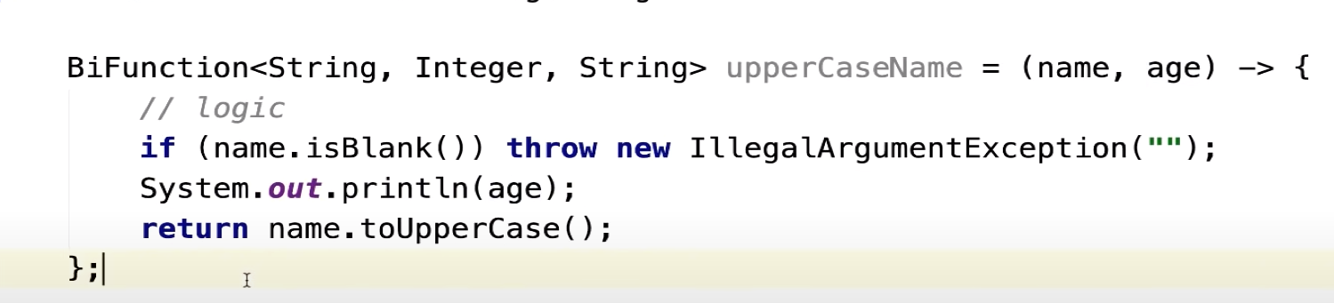
Lambda function
Example of lambda function

Slide 16
Reduction Operations
A reduction operation takes a sequence of input elements and combines them into a single summary result by repeated application of a combining operation.
Some of the standard reduction forms include sum(), max(), and count().
Computing the sum using a sequential loop:
int sum = 0;
for (int x : numbers) {
sum += x;
}
Computing the sum using a reduction operation:
int sum = numbers.stream()
.reduce(0, (x,y)->x+y);

Slide 17
Concurrency
New things related to concurrency as of Java 21:
Virtual threads now finalized (moved out of Preview), now with support for local variables to guarantee backwards compatibility.
Structured concurrency moved into Preview (out of incubation). Basically handles groups of related tasks running in different threads like a single unit of work.

Slide 18
Concurrency
An example of computing the sum of squares using just streams:
int sumOfSquares_a = numbers.stream().map(x -> x * x)
.reduce(0, Integer::sum);
An example of computing the sum of squares using concurrency in streams:
int sumOfSquares_b = numbers.parallelStream()
.map(x -> x * x)
.reduce(0, Integer::sum);

Slide 19
Ordering
Streams do not necessarily have a defined encounter order. Some source types have an implicit order, but that implicit order is not part of the stream.
We can use ordering to either guarantee the encounter order (helpful in parallel streams) or to produce a specific result when combined with other operations like findFirst().
An example of using ordering operation sorted():
List<Integer> sortedList = numbers.stream()
.sorted()
.collect(Collectors.toList());

